Slide 1
Final project
Group-15
1.Jaini Bhansali
2.Shamal Bhole
3.Shubhangi Lohote

Slide 2
Contents:
Data models
Sql queries from 3 perspectives:
Parent,Teacher,Administrator
Mysql Database migration and queries
Oracle migration and queries.
OLAP cubes
BI reports and Dashboards

Slide 3
Data models:
Absence model
Discipline behavior model
Special Programs model
Academic Performance model

Slide 4
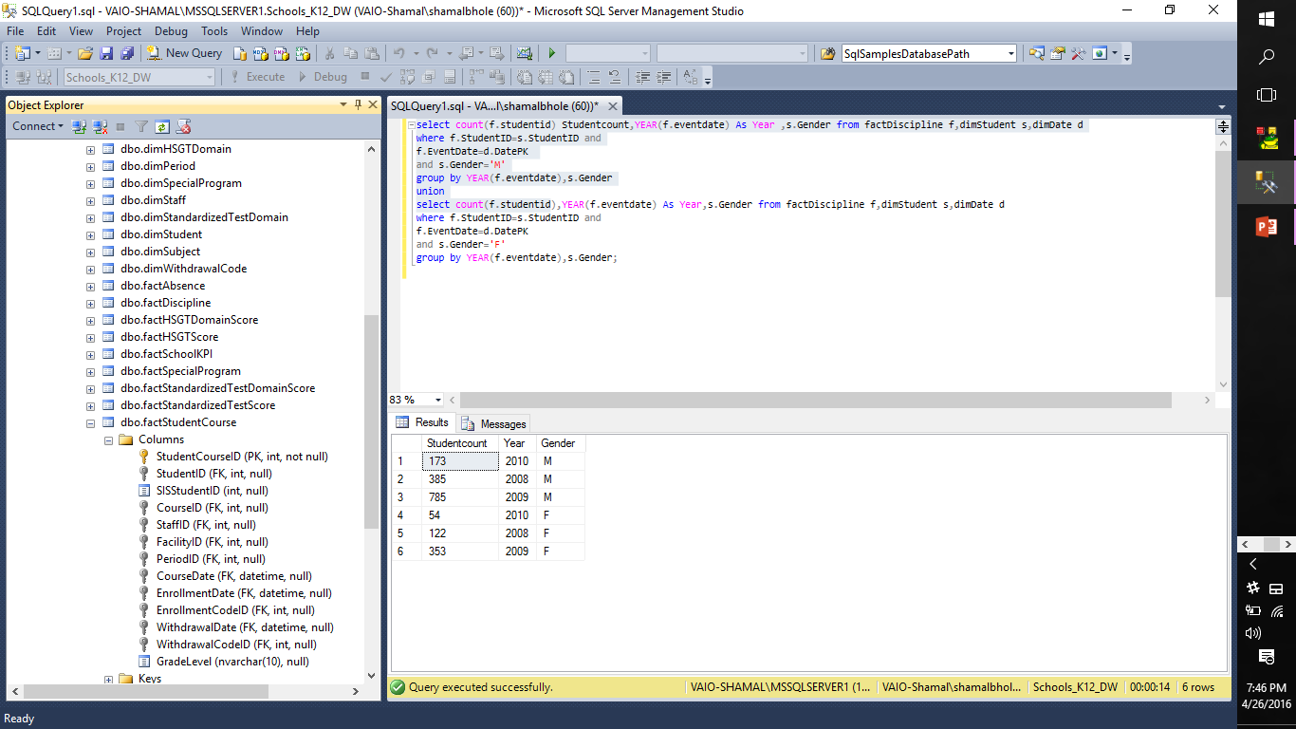
SQL Queries: 1. List total number of males and females involved in disciplinary actions on a yearly basis. (Discipline Model)

Slide 5
List the time difference between the disciplinary event taking place and the action date for each disciplinary event.
create view vw_actiondate as select * from dimDate;
create view vw_ eventdate1 as select * from dimDate;
select avg(DATEDIFF(day,f.EventDate,f.ActionDate)) ResponseDelay_NoOfdays,
Convert(varchar(30),e.year,102) Eventdate,de.DisciplineEventDesc,da.DisciplineActionDesc from
factDiscipline f,vw_eventdate1 e,vw_actiondate a,dimDisciplineActionCode da,dimDisciplineEventCode de
where f.ActionDate=a.DatePK and
f.EventDate=e.datepk and
f.DisciplineActionCodeID=da.DisciplineActionCodeID and
f.DisciplineEventCodeID=de.DisciplineEventCodeID
group by
e.year,f.ActionDate,f.EventDate,de.DisciplineEventDesc,da.DisciplineActionDesc;

Slide 6
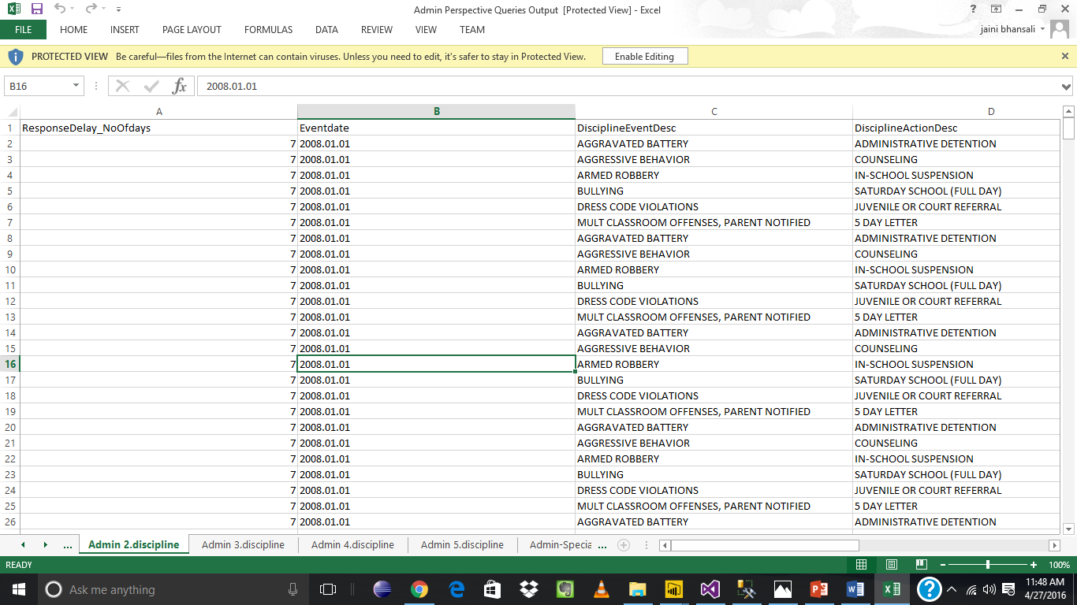
Result set

Slide 7
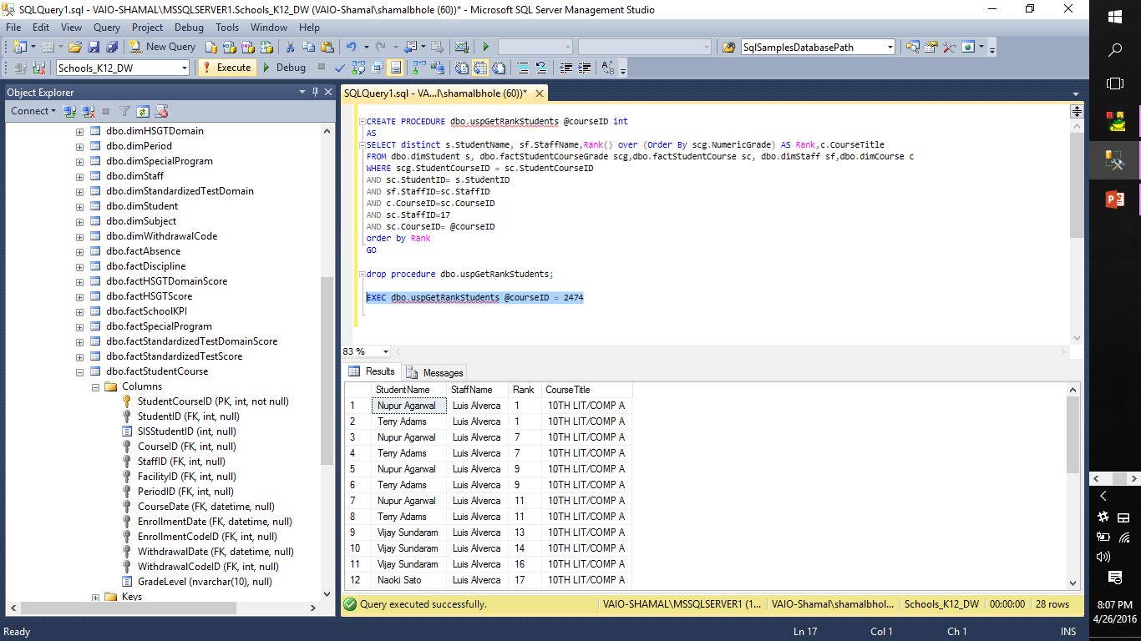
Write a procedure to order/rank the students according to their grades under a staff (input parameter will be course id)

Slide 8
Schools_K12_DW on Oracle
Query 1
Academic performance - Teacher perspective:
Number of students in a class who have HSGT scaled score greater than 550 for the respective teacher’s class.

Slide 9
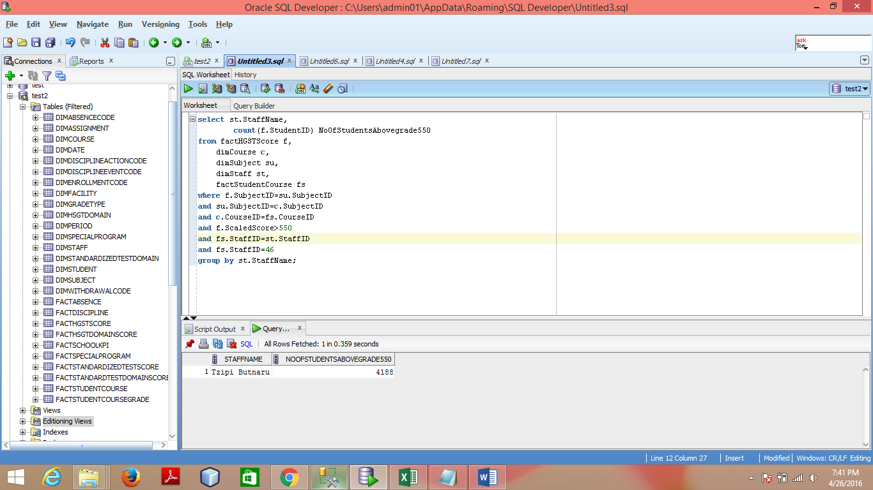
Result

Slide 10
Oracle Continued..
Query2
Discipline model - Parent Perspective
List disciplinary events with the disciplinary action taken against a student with description and dates.

Slide 11
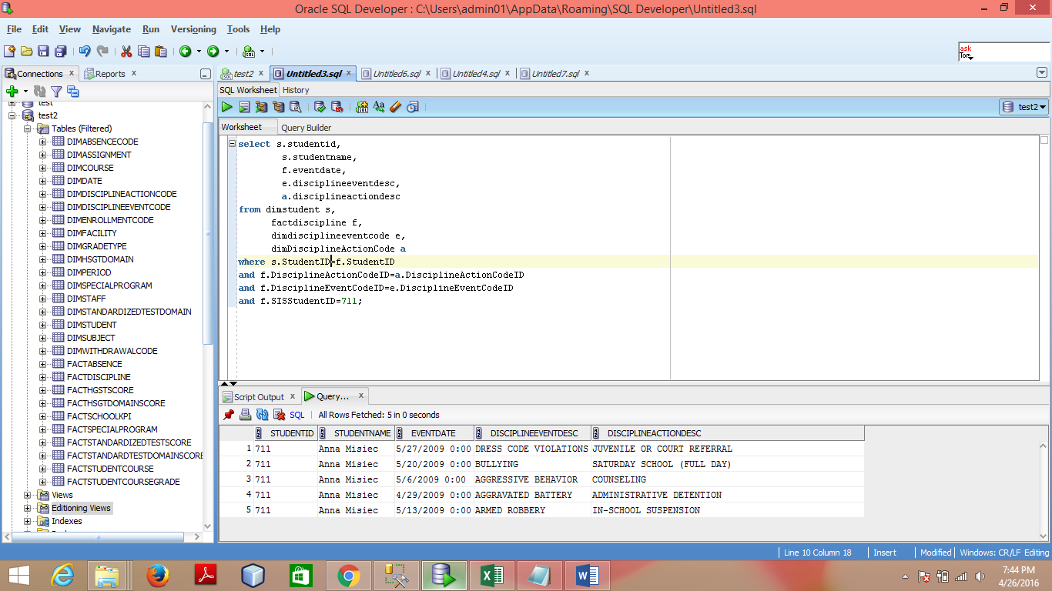
Result

Slide 12
Schools_K12_DW on MySQL
Query 1
List total number of males and females involved in disciplinary actions on a yearly basis.(Discipline Model-Admin perspective)

Slide 13
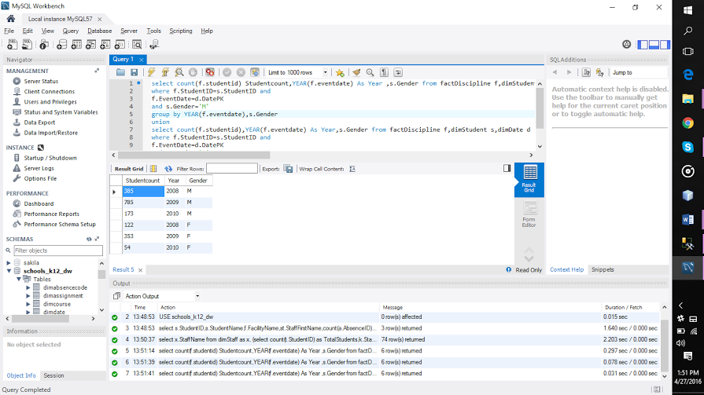
Result

Slide 14
MySQL continued..
Query 2
Details of HSGT scaled score and possible scaled score of a student for a particular subject and course(Academic Performance –Teacher perspective).

Slide 15
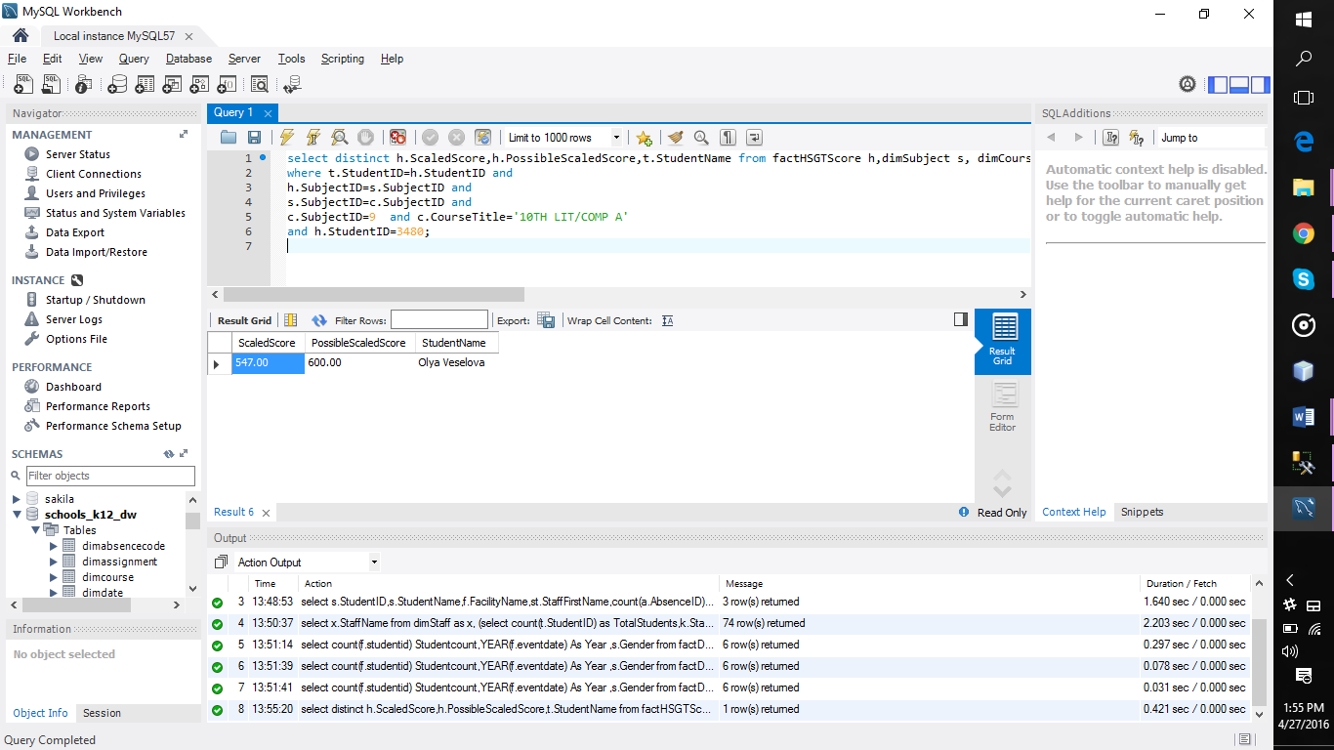
Result

Slide 16
OLAP CUBE Analysis Results using Power BI
Create new project.
Create a Data Source
Create a Data Source View
Create dimensions
Create a Cube
Modify and add measures
Adding attributes
Add Hierarchy
Build and deploy solution

Slide 17
Discipline Model

Slide 18
Discipline Model
Report 1 –Disciplinary event action details of a particular student.

Slide 19
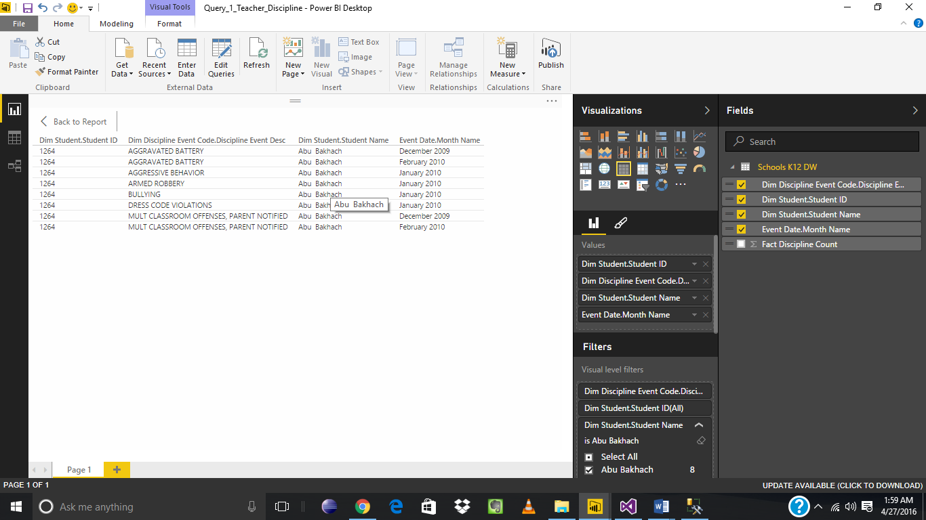
Parent Perspective

Slide 20
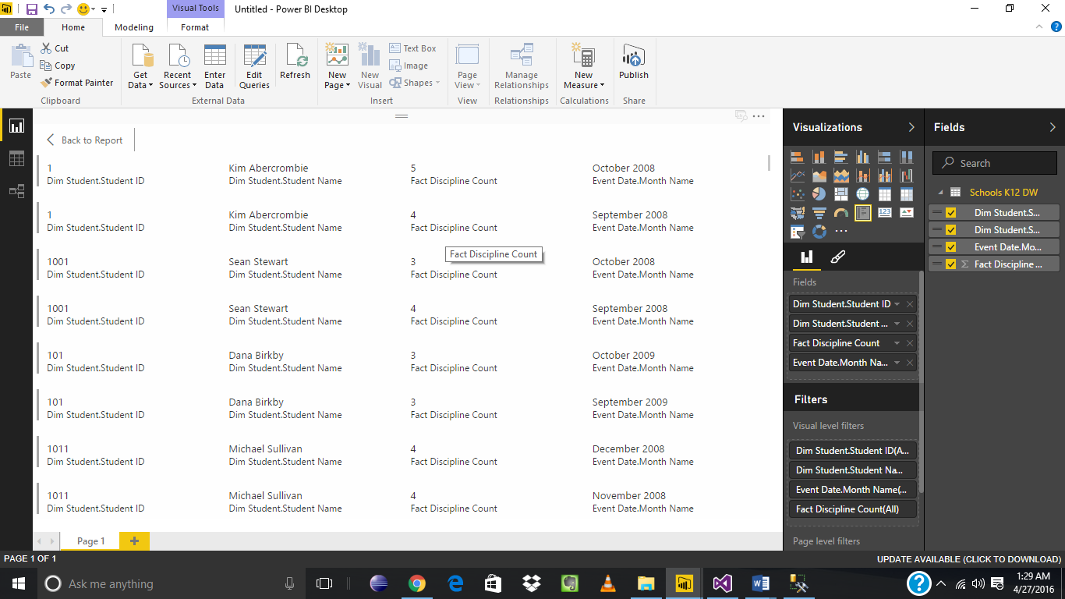
Teacher Perspective List count of disciplinary events for students on monthly basis-

Slide 21
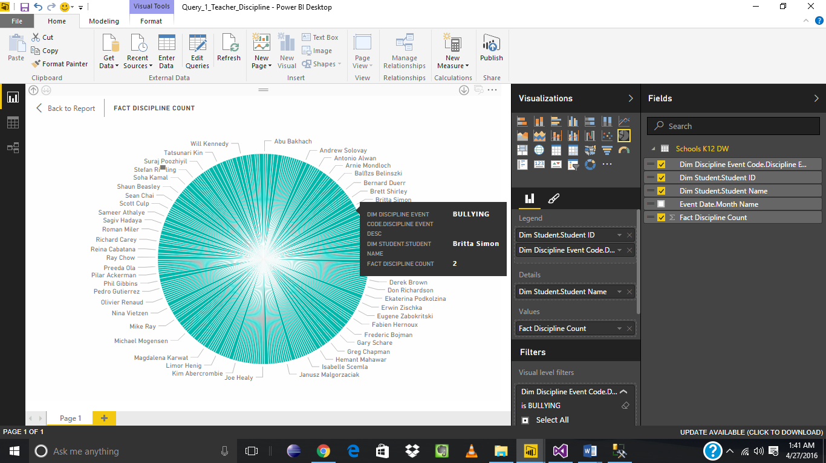
Teacher Perspective Number of times students involved in a disciplinary event bullying

Slide 22
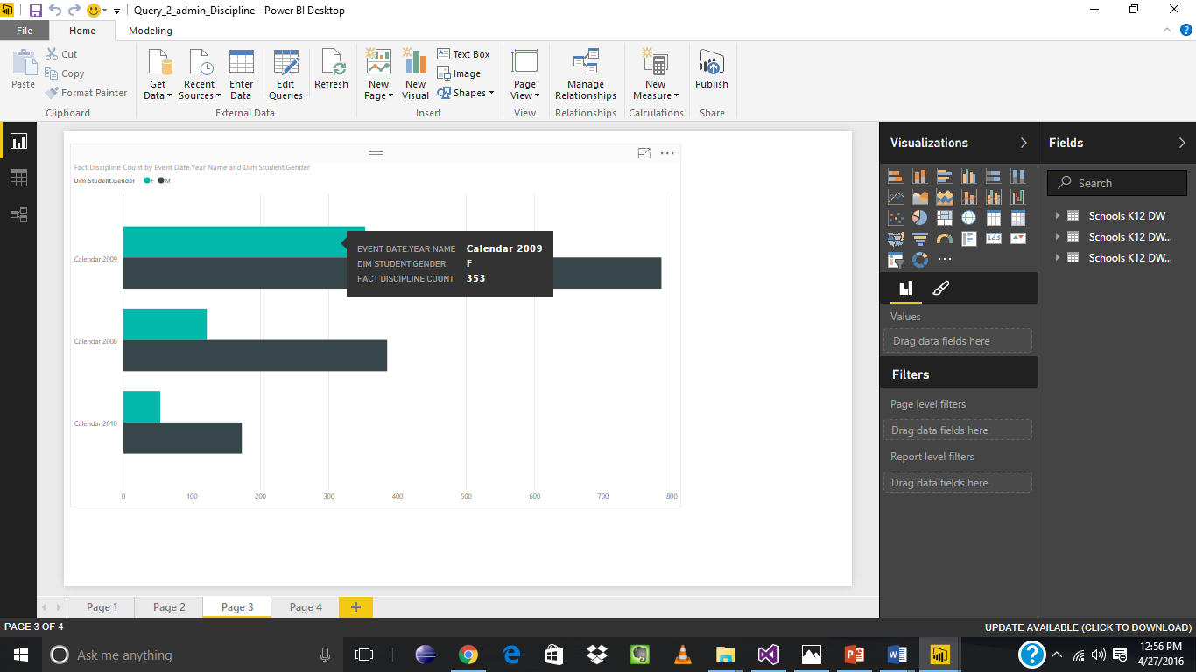
Administrator Number of male and female involved in disciplinary actions on yearly basis

Slide 23
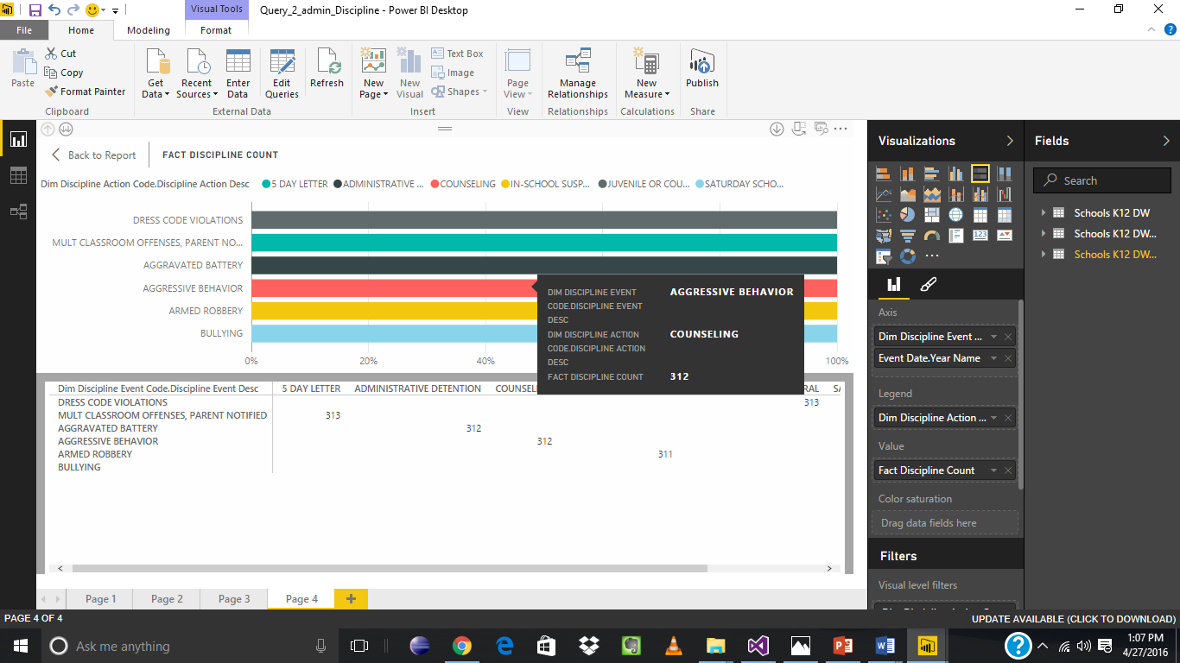
Analysis of number of disciplinary events in year and respective actions taken against it

Slide 24
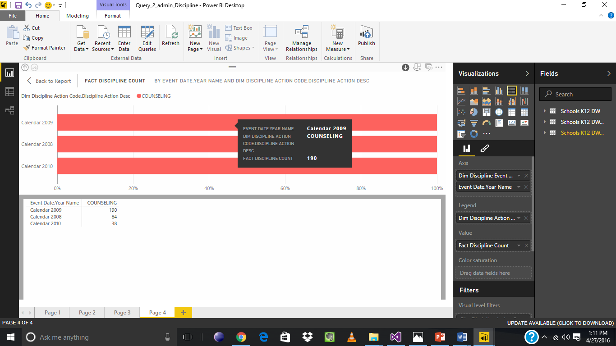
Analysis of number of disciplinary events in year and respective actions taken against it (Drilled down to number of students receiving a particular action ina year)

Slide 25
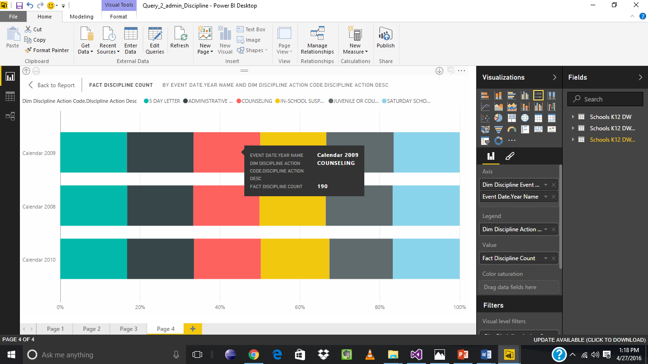
Analysis of number of disciplinary events in year and respective actions taken against it (Drilled down number of students receiving types of actions in a year)

Slide 26
Academic Performance

Slide 27
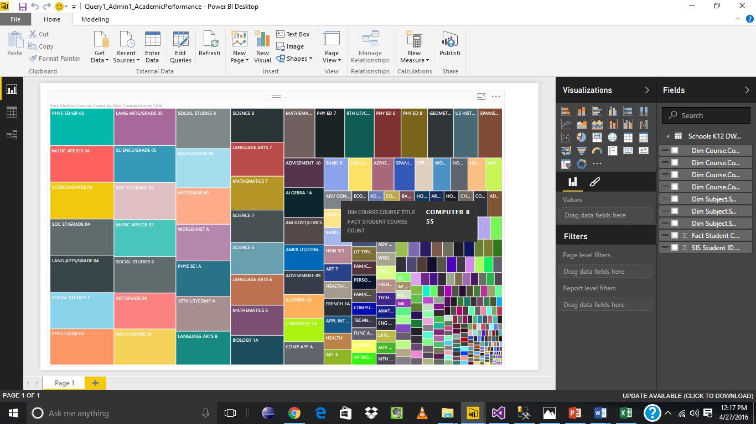
Administrator Analysis of enrollment of courses . A

Slide 28
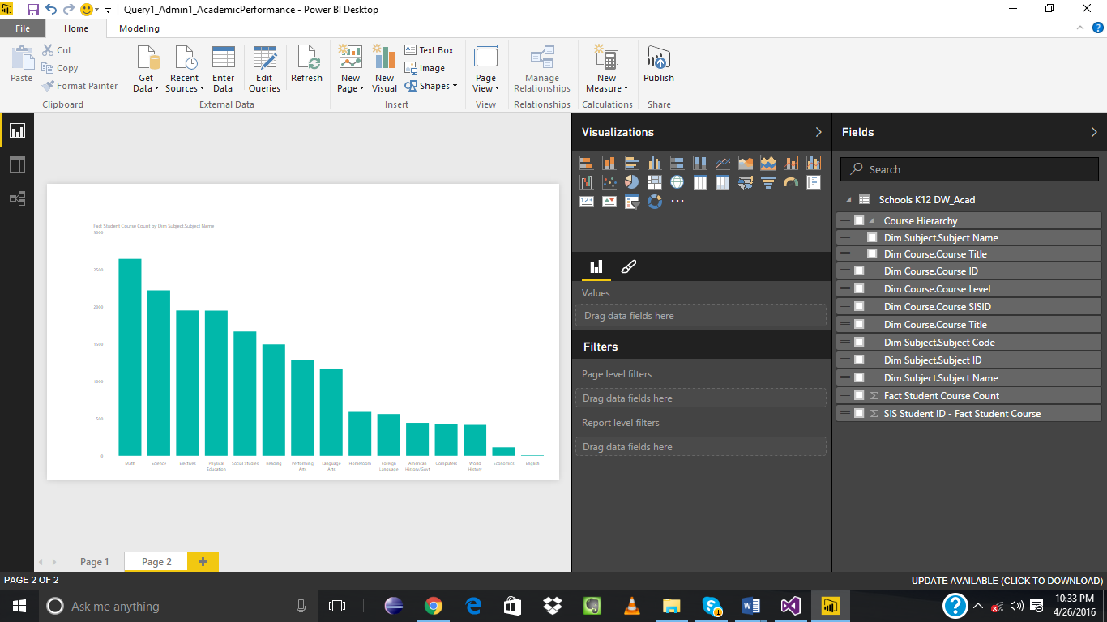
Teacher Hierarchical Drill Down of Subject wise-student count

Slide 29
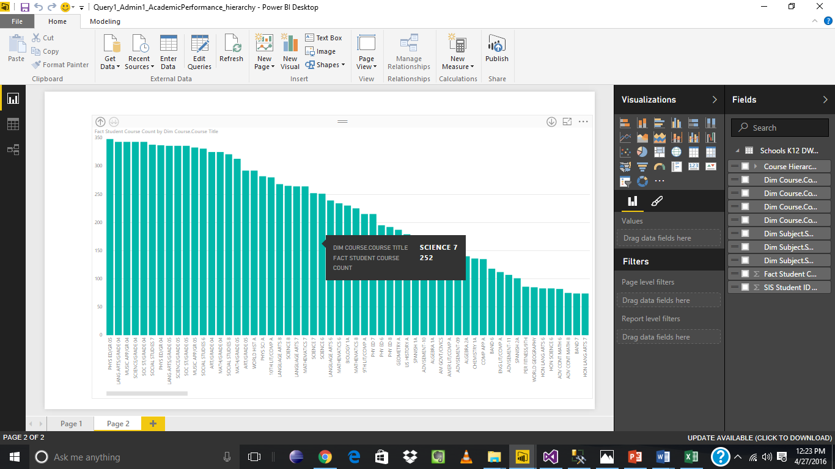
Hierarchical Drill Down (Course)

Slide 30
Absence Model

Slide 31
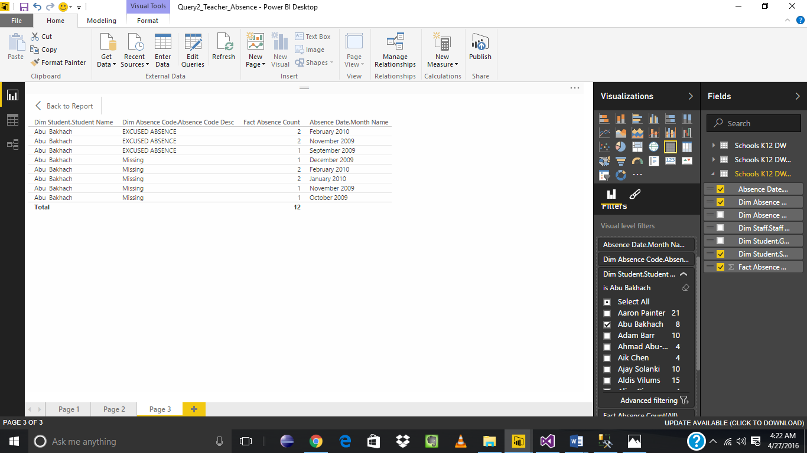
Parent A particular students details of absences on a monthly basis

Slide 32
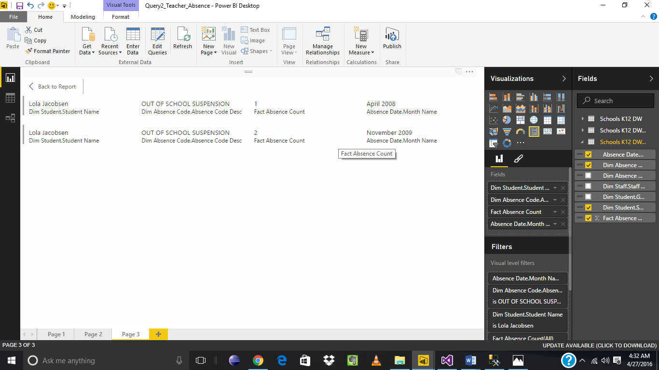
Parent Perspective Monthly analysis of a particular student with a suspension

Slide 33
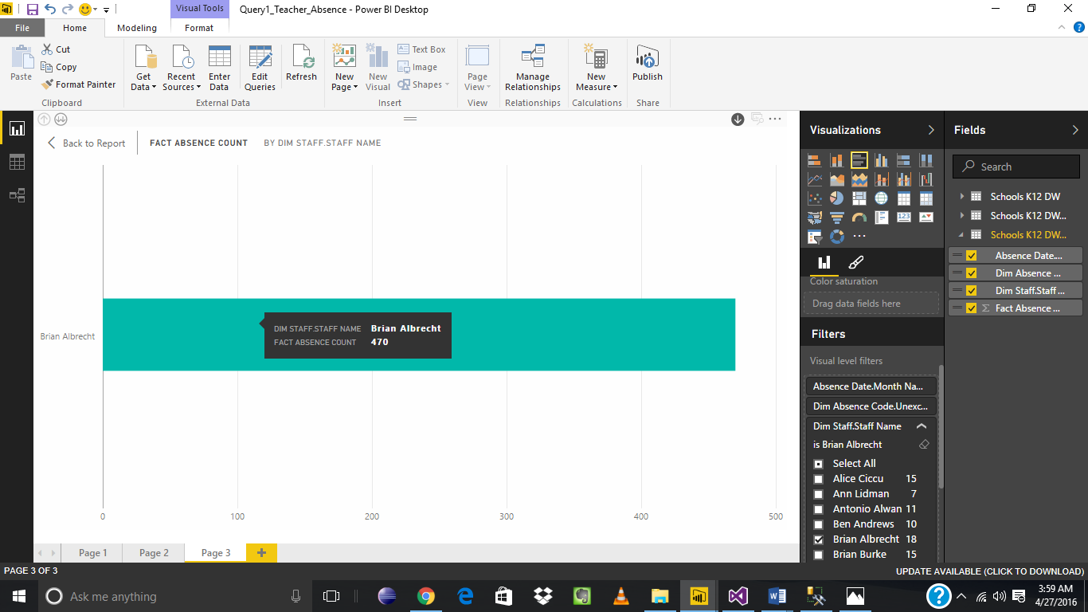
Teacher Perspective Number of absences for a particular teacher on a monthly basis (Drill down)

Slide 34
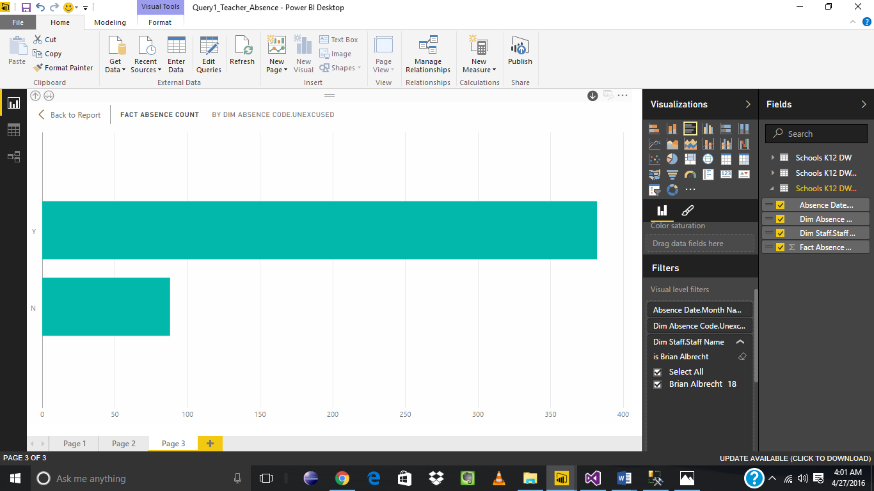
Drilled down to excused and unexcused status (drill down)

Slide 35
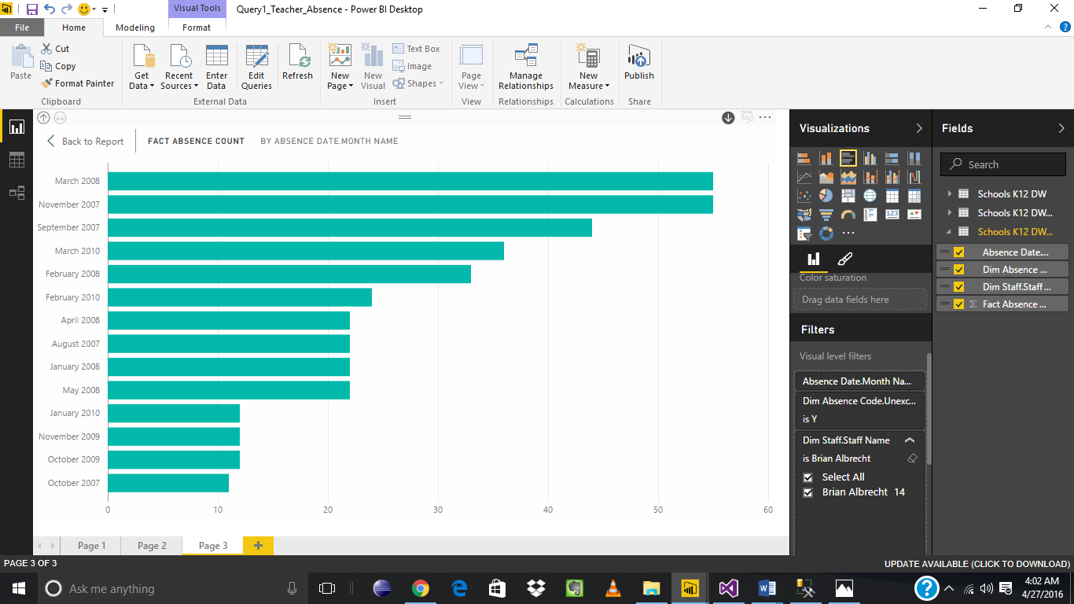
Monthly analysis of status report

Slide 36
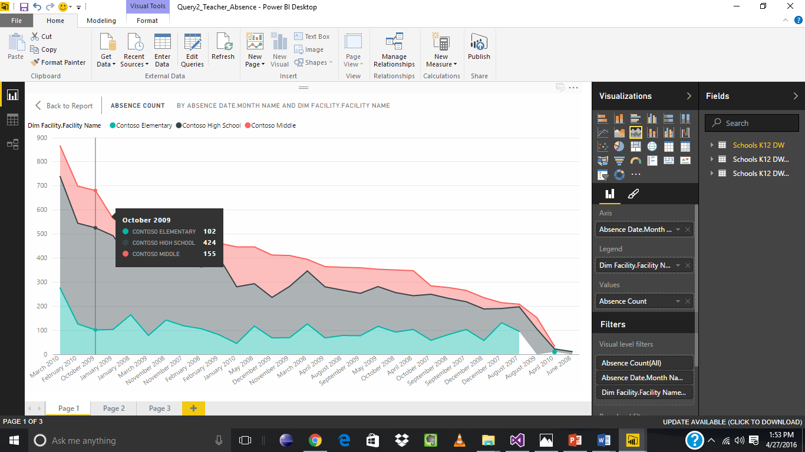
Administrator Perspective Monthly analysis of absences- facility wise

Slide 37
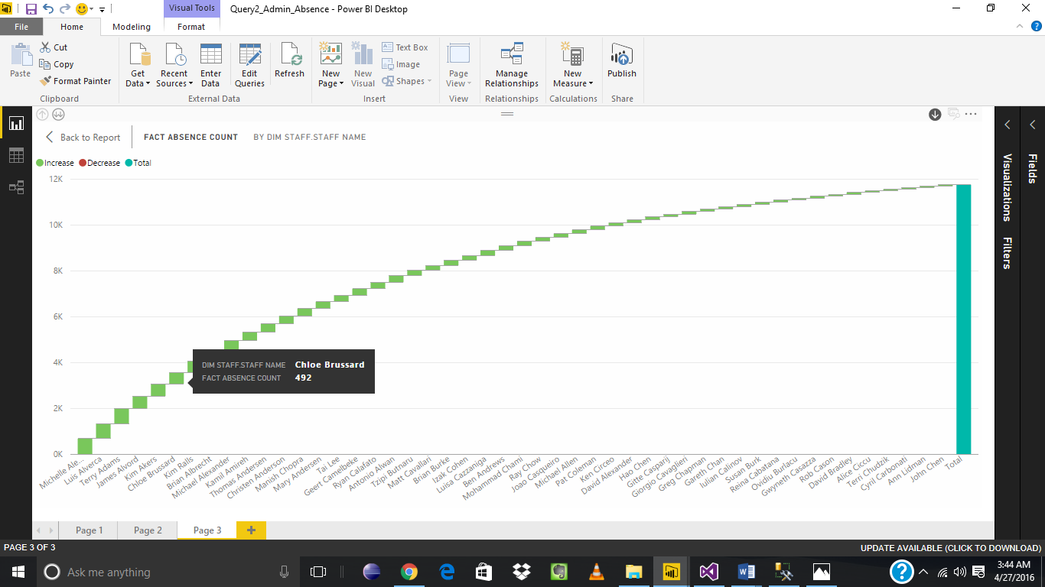
Administrator Monthly Report of all absences for respective staff (drilling down to monthly basis)

Slide 38
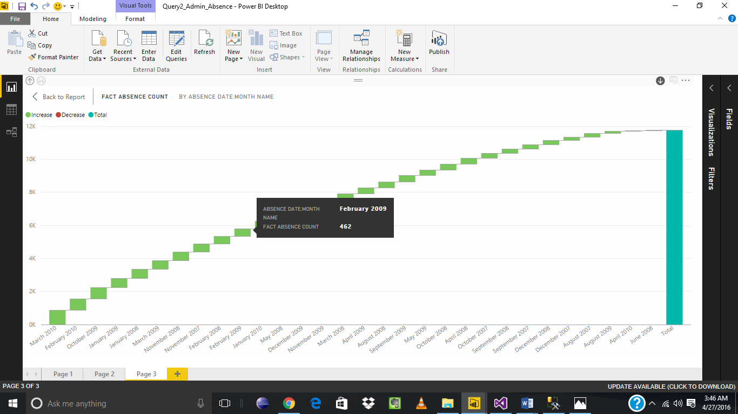
Drill down to monthly basis

Slide 39
Special Programs

Slide 40
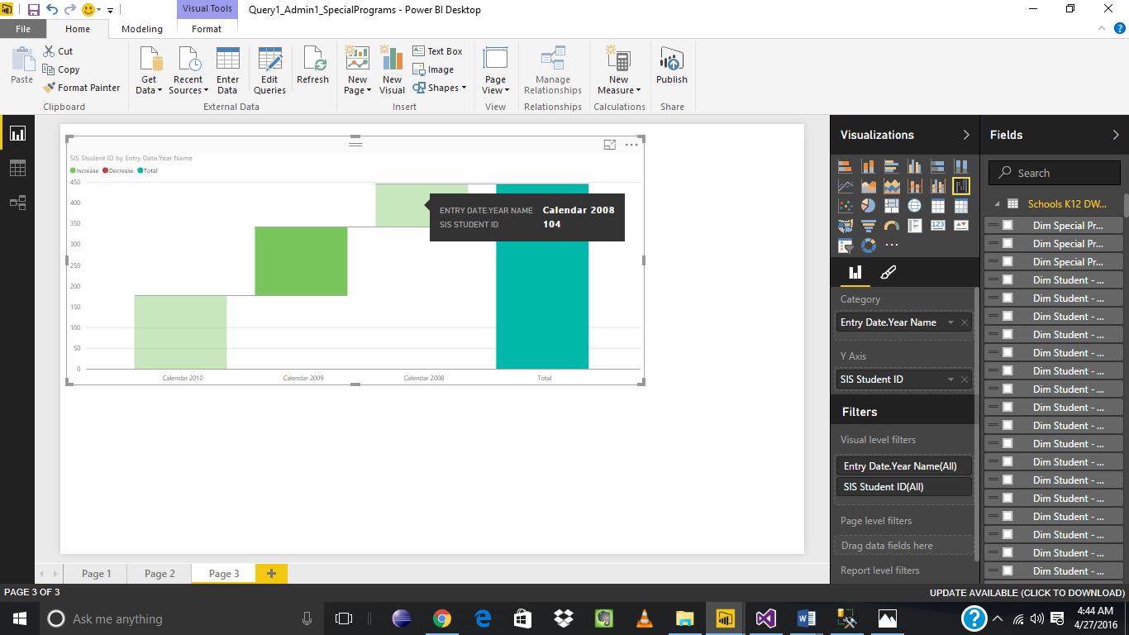
Administrator Total number of students in each program in one year.

Slide 41
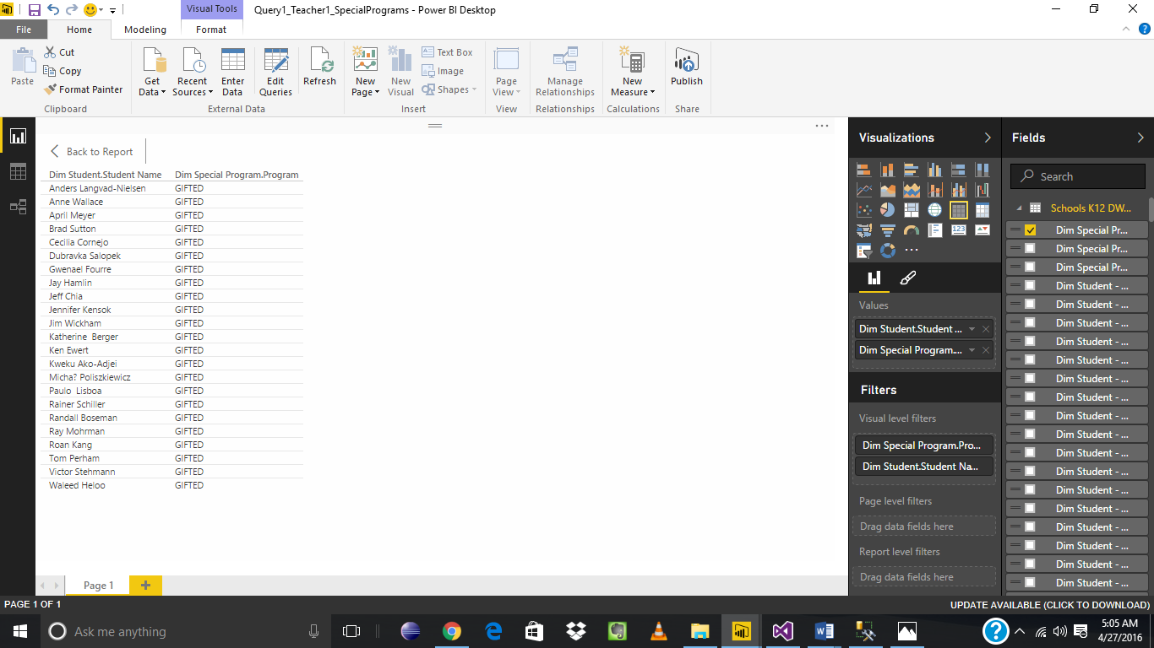
Teacher List of Students enrolled in a particular special program.

Slide 42
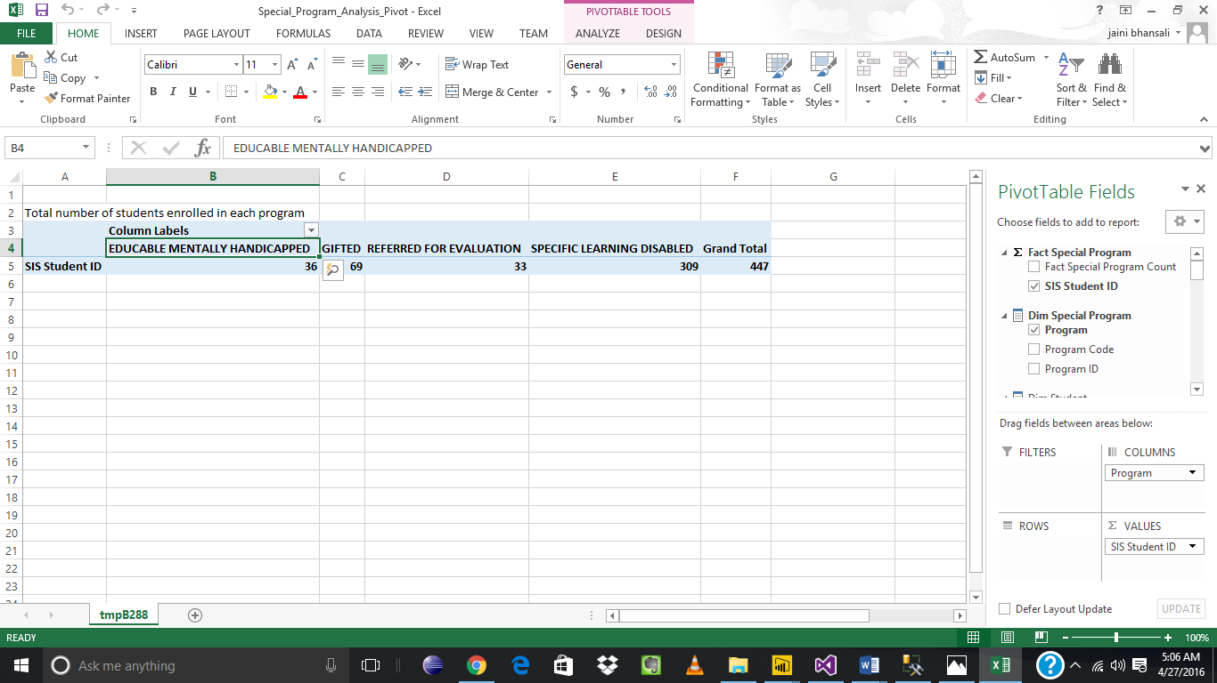
Administrator Total count of students in each program(Pivot table)

Slide 43
Thank you

